Slide 1

STANDARD CHARTERED HACKATHON
AI-ENHANCED SAVINGS GOAL TRACKER FOR WOMEN
SheVault
Presented by TEAM 9:
Misty Grover
Anshul Sharma
Niharika Gumpena
Megha
Manjiri sandeep pawar

Slide 2
PROBLEM STATEMENT
AI-Enhanced Savings Goal Tracker for Women
Our goal:
Develop a personalized and intuitive savings goal tracker.
Leverages AI and gamification for expense tracking and goal achievement.
Helps women visualize financial progress while ensuring privacy and security.

Slide 3
OUR APPROACH
Developed a user-centric app to help women manage finances effectively.
Key features:
Secure login & authentication for data protection.
Dashboard for visualizing spending trends.
Rewards System to encourage savings.
Chatbot for personalized financial advice.
Wallet to track savings.

Slide 4
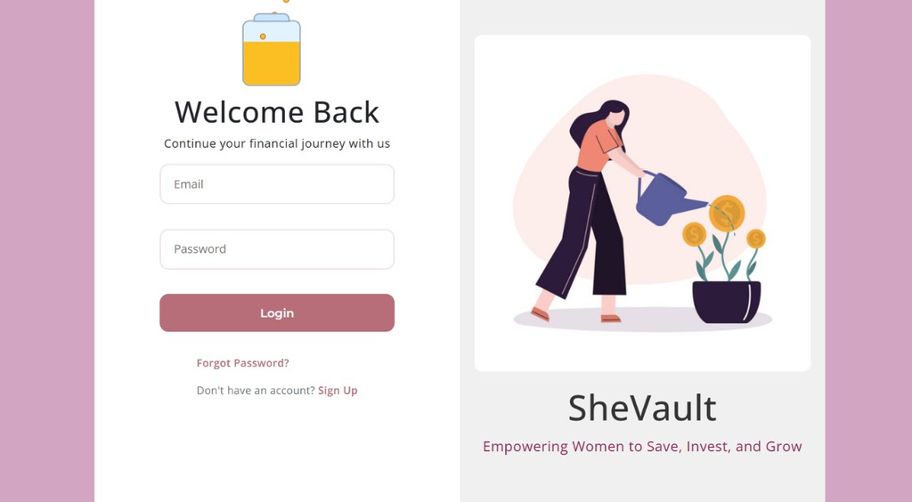
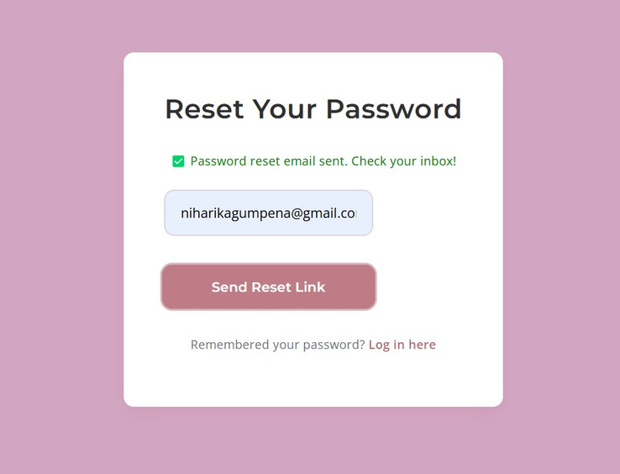
LOGIN AND AUTHENTICATION
Secure sign-up and sign-in process.
Email verification and password encryption.
Account recovery options.
Importance:
Protects sensitive financial data.
Ensures authorized access with strong encryption.
Simple yet secure authentication for user convenience.

Slide 5
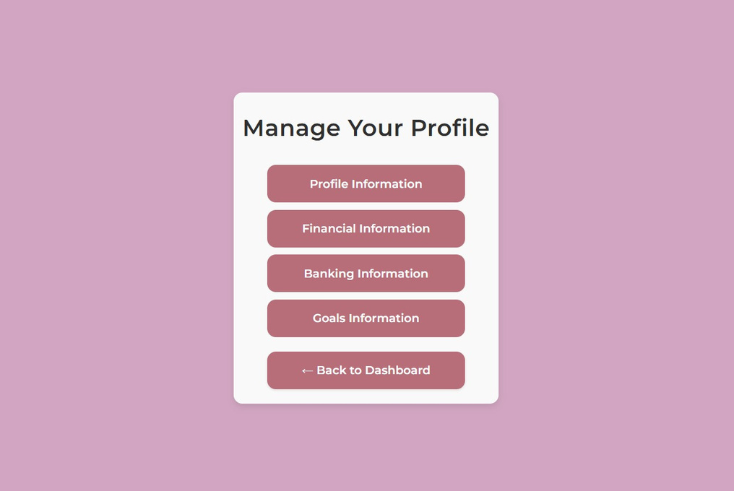
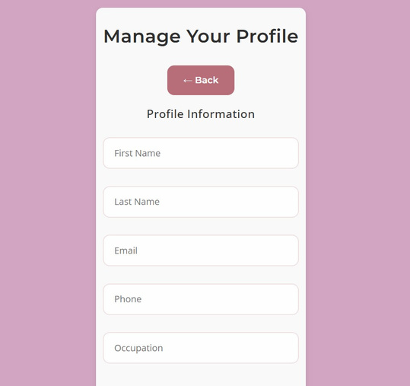
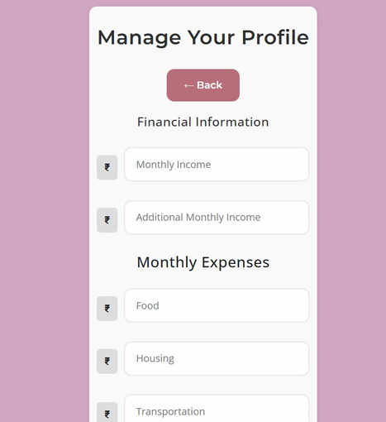
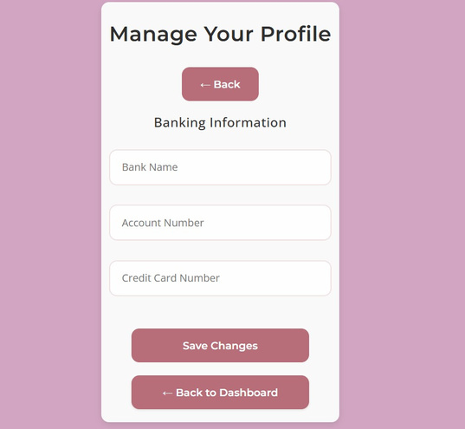
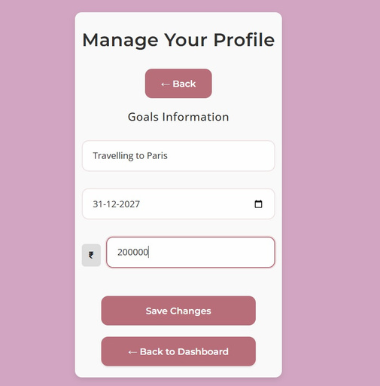
PROFILE SECTION
Input and manage personal financial information.
Track income, savings goals, and transaction history.
Provides tailored financial advice.
Importance:
Central to personalized financial insights and recommendations.
Enables smarter budgeting and goal setting.

Slide 6
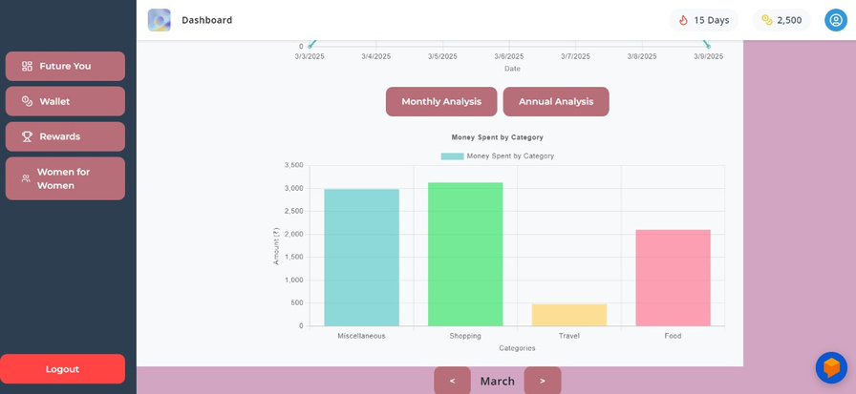
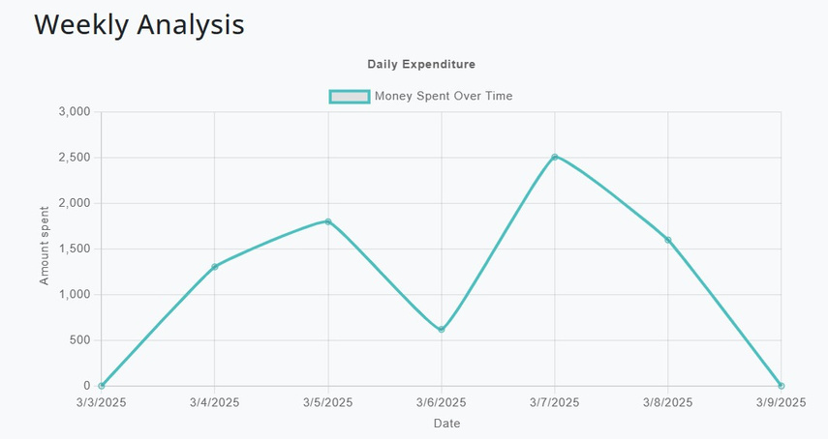
DASHBOARD
Visualize financial data with interactive charts and graphs.
Track monthly and weekly expenses across categories.
Identify spending trends and make informed decisions.
Importance: Helps users stay informed and motivated to manage finances.

Slide 7
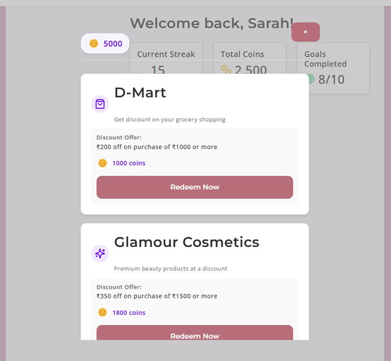
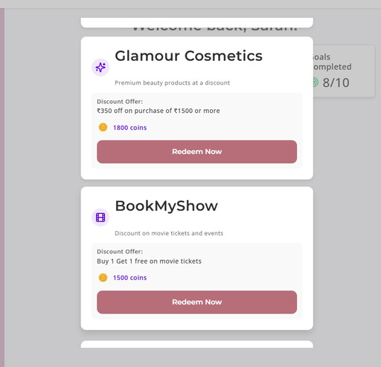
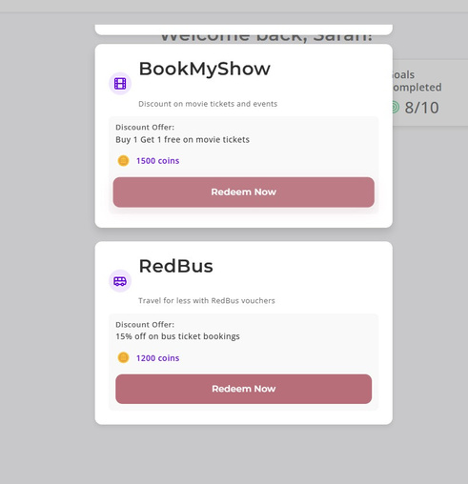
REWARDS SECTION
Earn coins for savings and financial milestones.
Redeem coins for vouchers and discounts.
Gamified element to encourage saving.
Importance: Motivates users to save and engage with the app.

Slide 8
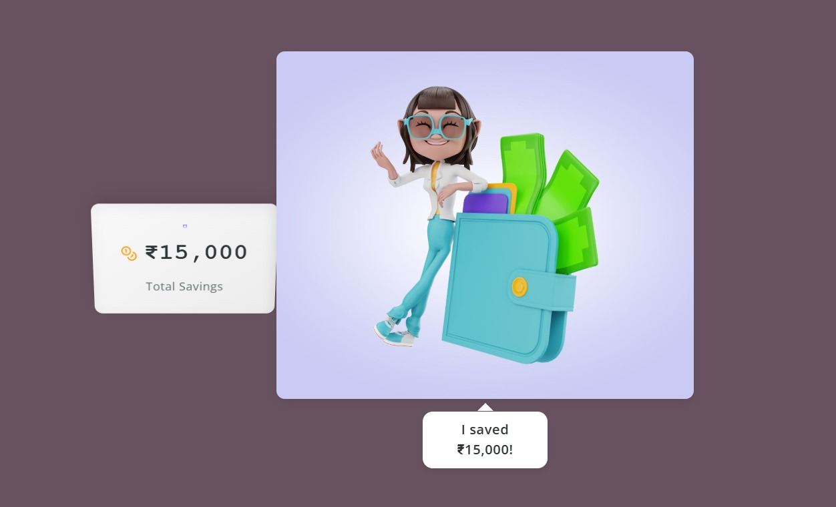
WALLET
Provides a snapshot of financial status, including savings.
Updates automatically upon reaching milestones based on uploaded transaction and income data for easy monitoring of financial health.

Slide 9
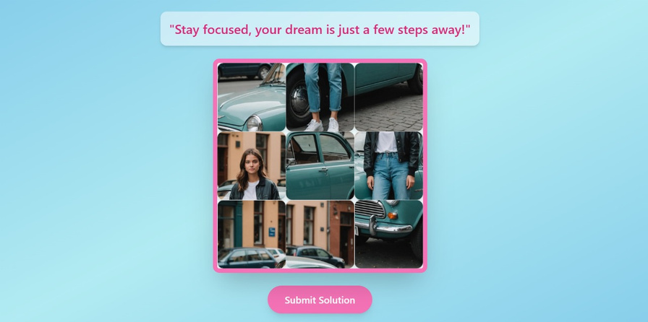
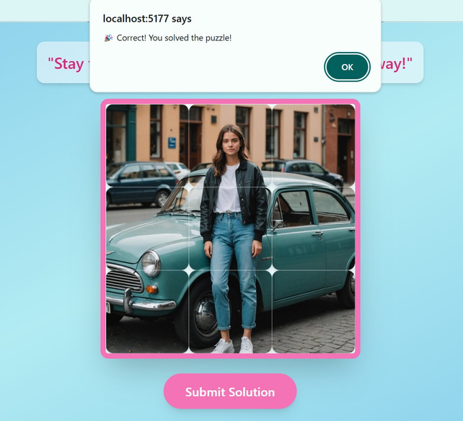
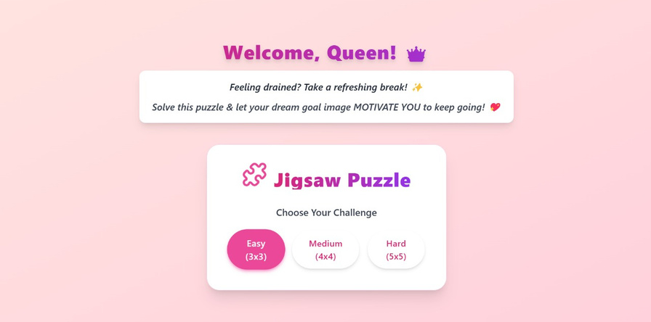
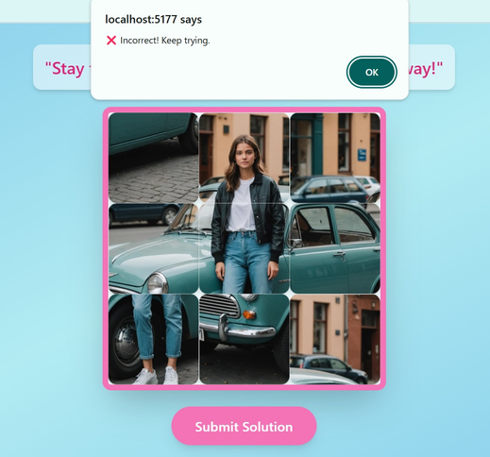
FUTURE YOU
Interactive jigsaw puzzle representing future self.
Unlock puzzle pieces by meeting savings goals.
Visual representation of financial progress.
Importance: Gamifies financial progress and keeps users engaged.

Slide 10

FUTURE YOU
An image which was generated based on the goal

Slide 11
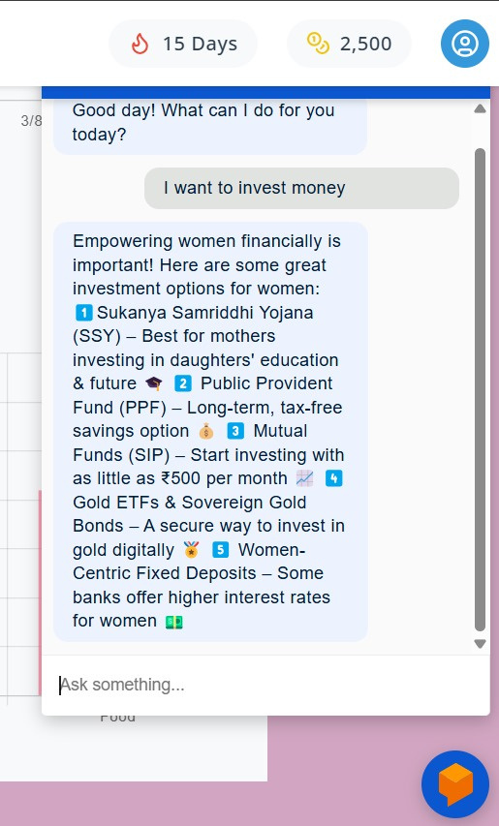
CHATBOT
24*7 virtual financial assistant.
Provides personalized advice and budgeting tips.
AI-powered for accurate and relevant responses.
Importance: Enhances user experience with instant support.

Slide 12
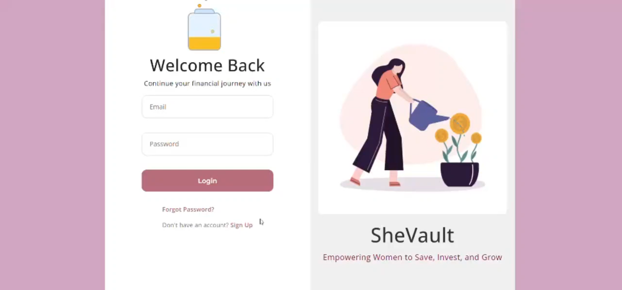
DEMO

Slide 13
FUTURE SCOPE
Women for Women: A job platform where women offer opportunities to other women.
Banking & Payment App Integration: Auto-fetch transactions for better expense tracking.
Daily Motivation: A “Girly Quote” every day to inspire financial confidence.
Enhanced Rewards & Streaks: Get rewarded for daily savings & financial discipline.

Slide 14
CONCLUSION
This app offers a
Holistic approach to financial management.
Combines user-friendly features with gamified elements.
Empowers users to take control of their financial future.
By integrating rewards, interactive features and personalized assistance, we’ve created an app that not only helps users manage their finances but also makes the process enjoyable and motivating.

Slide 15
THANK YOU

